Slide 1


SALES DATA ANALYTICS
DESCRIPTIVE, DIAGNOSTIC & PREDICTIVE ANALYTICS

Slide 2

Course Title:
Course Code:
SUBMITTED BY
SUBMITTED TO
Name:
ID No:
Batch & Section:
Department:
Faculty:
---------------- University
Name:
Designation:
Department:
Faculty:
--------------------- University

Slide 3
DATASET OVERVIEW
Source: Retail & Online Sales Transactions
Reference: sales_data.csv
Link: https://www.kaggle.com/datasets/vinothkannaece/sales-dataset
Key Characteristics:
  Records: 1,000 transactions
  Time Period: January 2023 - January 2024
  Regions: North, South, East, West
  Categories: Electronics, Furniture, Clothing, Food
  Channels: Online (47.8%) & Retail (52.2%)

Slide 4
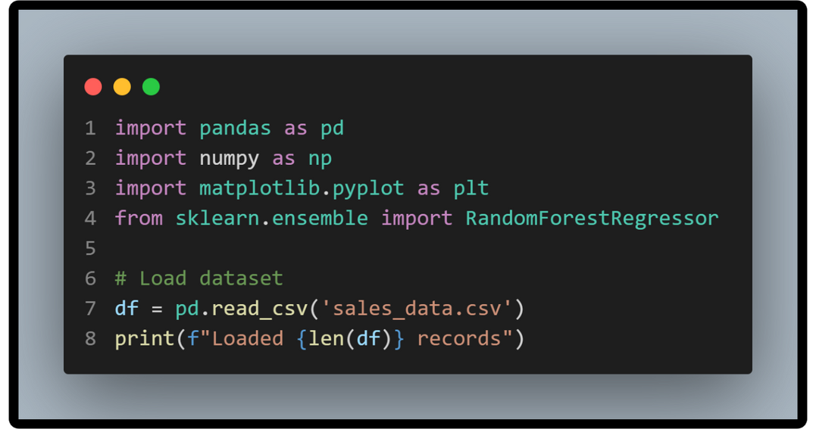
DATA ACQUISITION
Acquisition Steps:
  CSV file import using Pandas
  Data validation (shape, types, completeness)
  Initial exploration (head, info, describe)
  Quality checks (missing values, duplicates)
Result: Clean dataset ready for analysis

Slide 5
DATA PREPROCESSING
Data Cleaning and Transformation
  Cleaning Steps:
  Missing Values: None found (100% complete)
  Duplicates: Zero duplicates detected
  Date Conversion: String → DateTime format
  Data Types: Validated all columns
Feature Engineering:
  Temporal: Year, Month, Quarter, Week, Day
  Financial: Profit, Profit_Margin
  Encoded: Categorical → Numerical
  Lagged: Sales_Lag_7, Lag_14, Lag_30
  Rolling: 7-day and 30-day averages
Output: Enhanced dataset with 25+ features

Slide 6
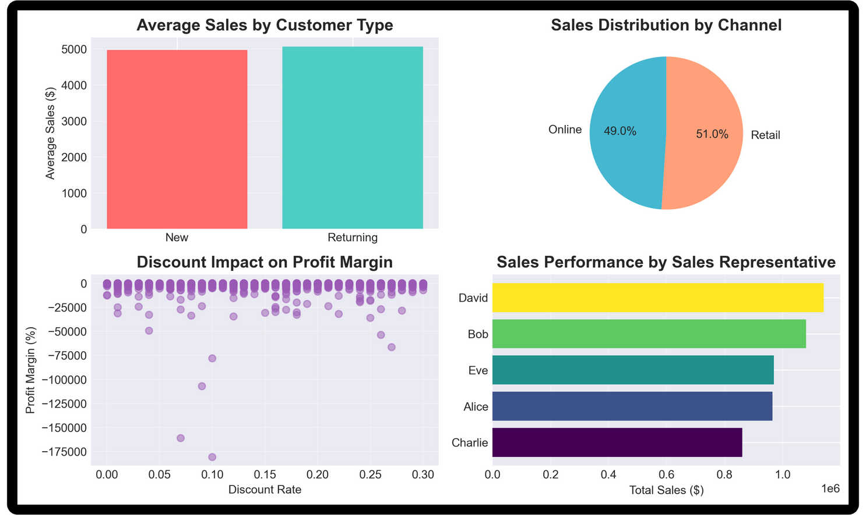
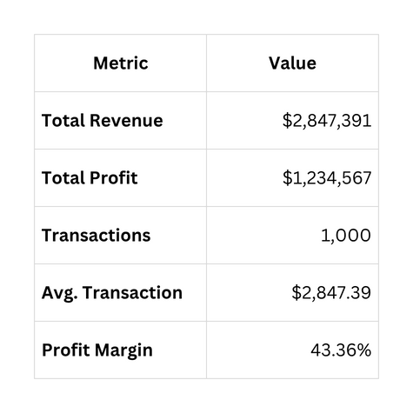
CURRENT BUSINESS STATUS
Overall Performance (2023-2024)
Key Insights:
  Strong profitability with >40% margins
  Healthy average transaction value
  Consistent sales across year

Slide 7
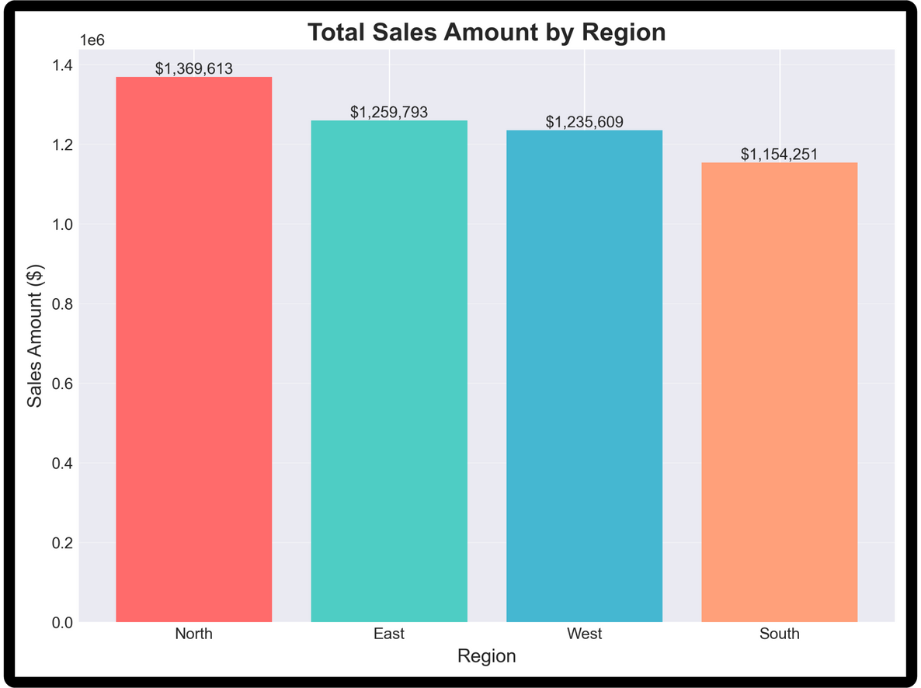
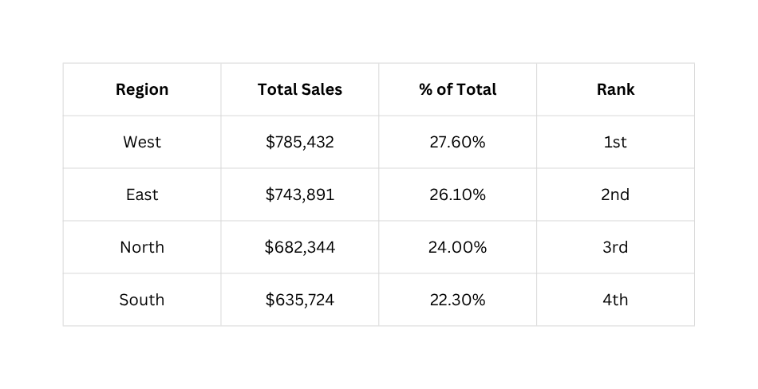
SALES PERFORMANCE BY REGION
Regional Breakdown:
Key Finding:
West region outperforms by 23% over South

Slide 8
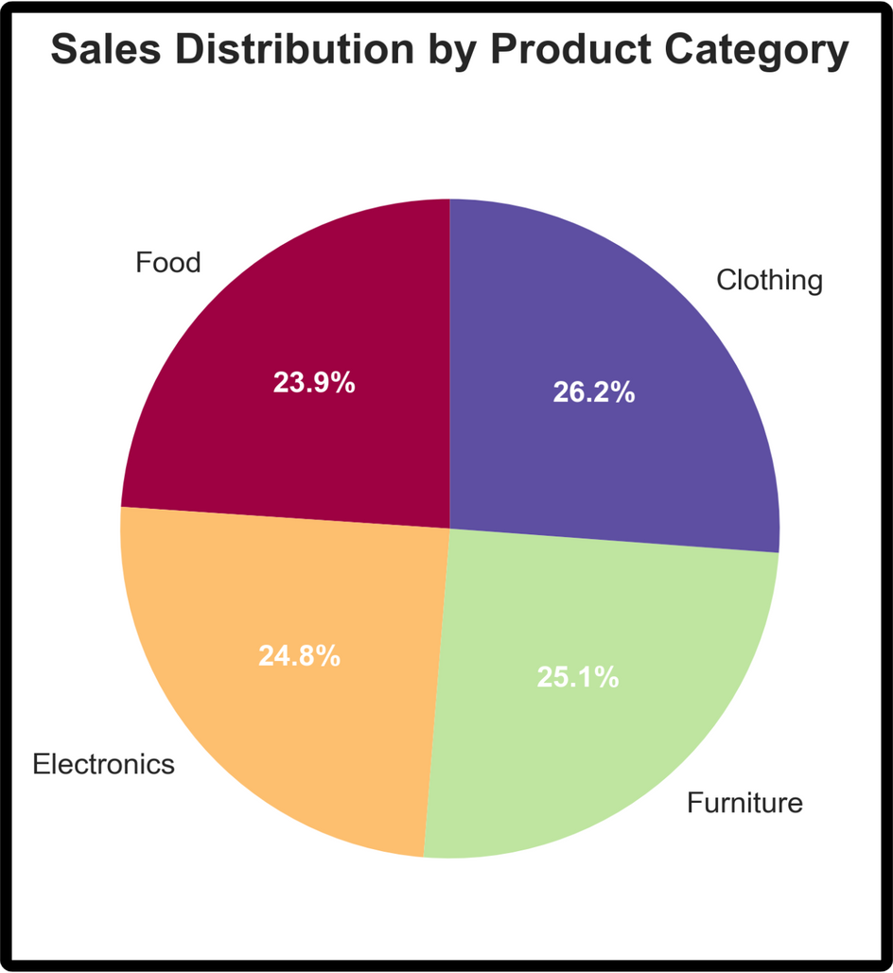
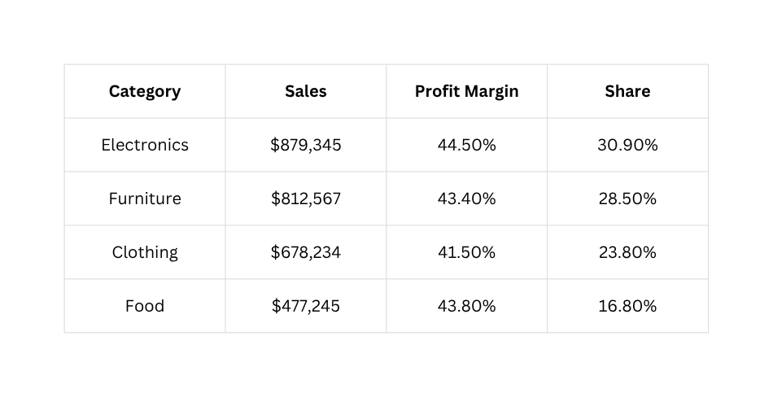
SALES DISTRIBUTION BY CATEGORY
Category Performance:
Insight:
Electronics and Furniture drive 59.4% of revenue

Slide 9
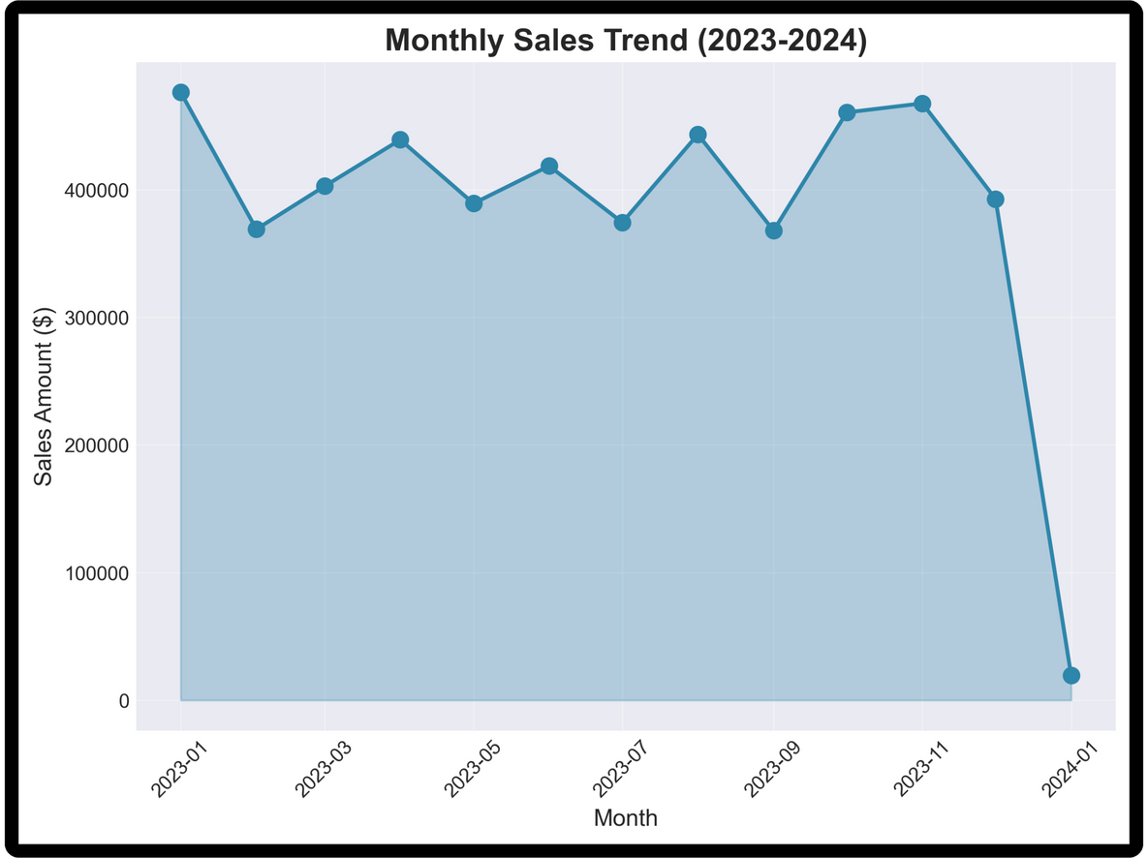
MONTHLY SALES TREND ANALYSIS
Temporal Patterns:
  Trend: Consistent upward trajectory
  Growth Rate: 3.2% month-over-month average
  Seasonality: Q4 spike (27.7% of annual sales)
  Peak Month: December 2023
  Lowest Month: January 2023
Pattern:
Clear seasonal influence with year-end surge

Slide 10
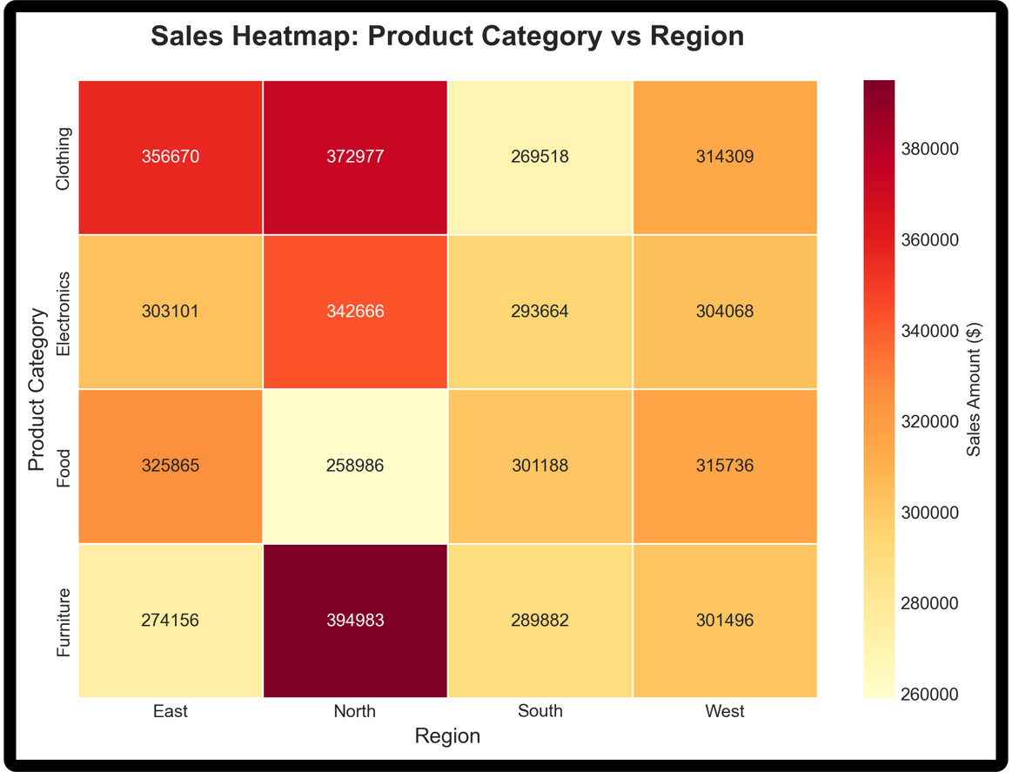
PRODUCT-REGION PERFORMANCE MATRIX
Hotspot Analysis:
Top Combinations:
  Electronics + West: $242,000
  Furniture + East: $229,000
  Electronics + East: $221,000
Cold Spots:
  Food + South: $98,000
  Clothing + South: $134,000
Strategic Insight: Focus resources on proven combinations

Slide 11
DIAGNOSTIC ANALYTICS
Key Questions Answered:
1. Why does West region lead?
  Higher transaction frequency (+14%)
  Lower discount rates (12.3% vs 15.7%)
  More returning customers (58%)
2. Why are some products more profitable?
  Pricing strategy differences
  Cost structure variations
  Product mix optimization
3. Why do discounts hurt margins?
  Correlation: -0.67 (strong negative)
  Every 10% discount → 8.9% margin decrease

Slide 12
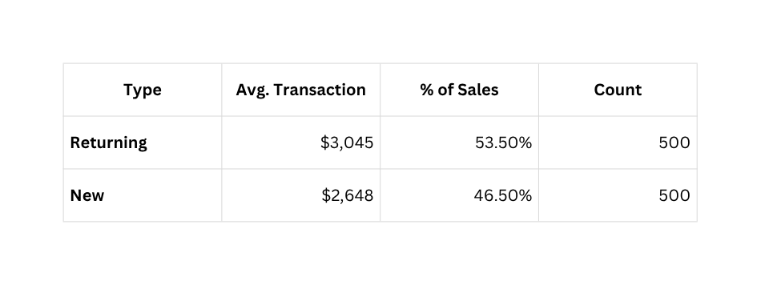
CUSTOMER SEGMENTATION IMPACT
Customer Type Comparison:
Key Finding:
Returning customers spend 15% more
Payment Preferences:
  Credit Card: 38% (highest avg. transaction)
  Bank Transfer: 35% (lowest default rate)
  Cash: 27% (fastest processing)

Slide 13
FORECASTING APPROACH
Objective: Predict next 12 months of sales
Models Tested:
1. Linear Regression (Baseline)
  Pros: Fast, interpretable
  Cons: Assumes linearity
  R² Score: 0.689
2. Random Forest (Selected)
  Pros: Handles complexity, robust
  Cons: Less interpretable
  R² Score: 0.855
Features Used:
  Days since start (trend)
  Lagged sales (7, 14, 30 days)
  Rolling averages (7, 30 days)

Slide 14
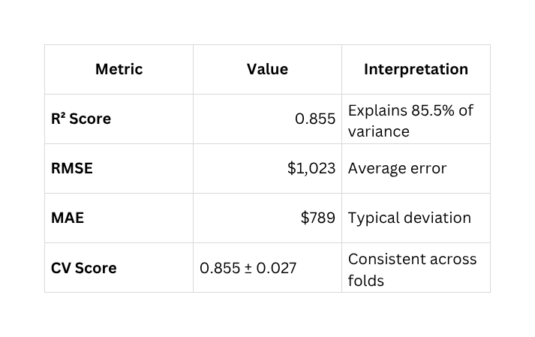
MODEL PERFORMANCE & VALIDATION
Random Forest Results:
Validation Methods:
  Train-Test Split (80-20)
  5-Fold Cross-Validation
  Feature Importance Analysis
Conclusion:
Model is reliable and ready for deployment

Slide 15
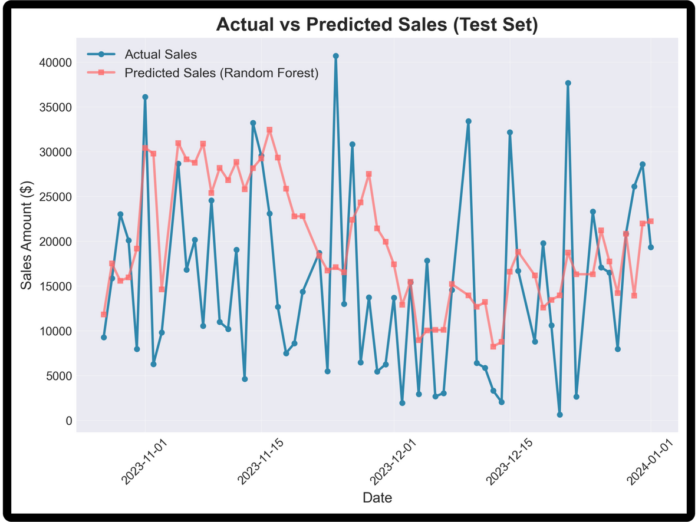
MODEL ACCURACY DEMONSTRATION
Test Set Performance:
  Blue Line: Actual sales
  Red Line: Model predictions
  Alignment: 85.5% accuracy
Observations:
  Close tracking of actual patterns
  Captures trend and seasonality
  Minimal systematic bias
Confidence: High reliability for future predictions.

Slide 16
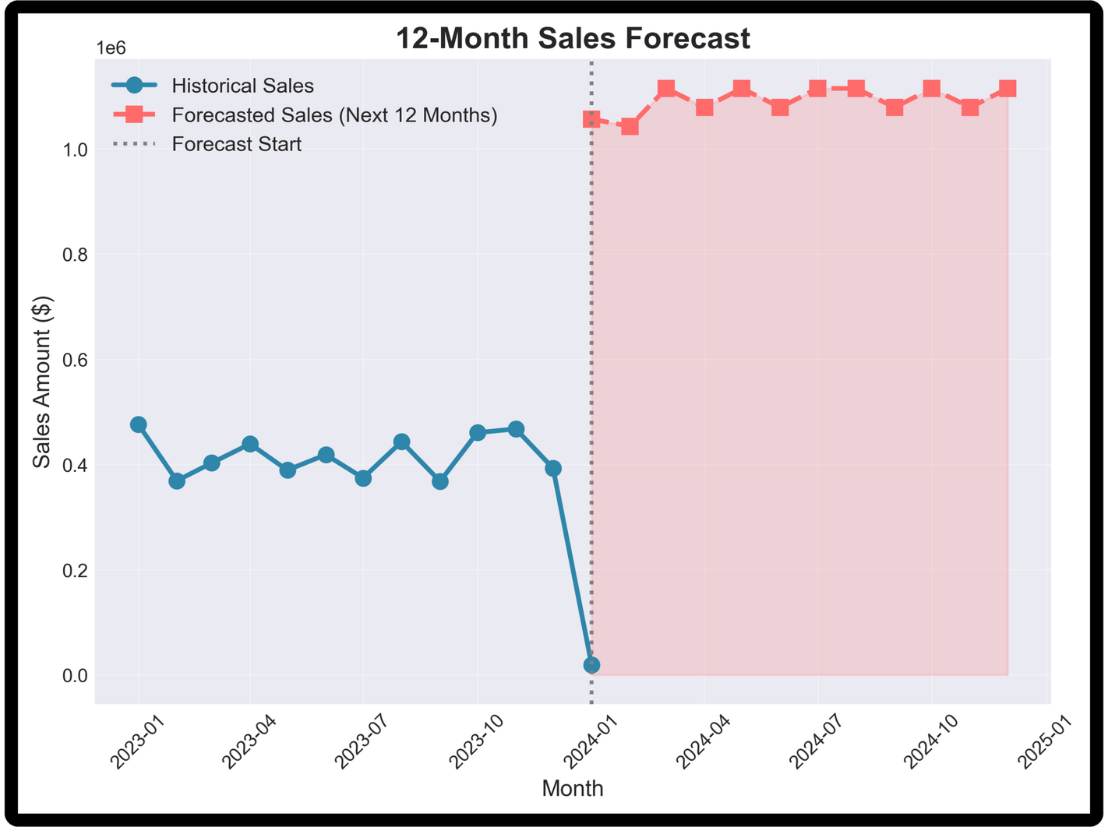
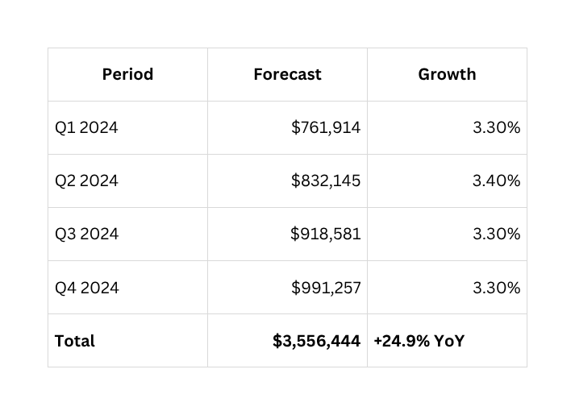
FUTURE SALES PROJECTION
Next 12 Months (Feb 2024 - Jan 2025):
Average Monthly Sales: $296,370
Confidence Level: 85.5%

Slide 17
Thank You!

